Slide 1

US Housing Prices Machine Learning Model
Team Outliers

Slide 2




Team Outliers
Matt Hardy
Ruchi Mathur
Kathy Nwe
Paula Thompson

Slide 3
Project Focus
Create a machine learning model to predict housing prices across various regions based on inflation rates, unemployment rates, gas prices, interest rates and average mortgages
40-year high in inflation rates
Interested in understanding the impact these aggressive increases will have on housing prices across our various locations.
Can we predict housing prices based on the above variables across different regions in the United States?
Question

Slide 4
Project Flow Chart
Datasets (CSVs, Labeled):
Consumer Price Index
Housing Prices
Mortgage Rates
Gas Prices
Unemployment Rates
Data Transformation:
Dropping null values
Filtering dates
Dropped unnecessary columns
Transposed data
Set date as index, region id as column headers
Converted date to uniform date-time
Assigned zips and coordinates to locations
Database:
Postgres
Compiled CSV
Machine Learning Model:
Multiple Linear Regression Model
Model Evaluation:
Adjusted R2

Slide 5
Technologies, Languages, Tools, Etc.
Data Preprocessing
Database
Machine Learning
Dashboard
Python
Pandas
Uzaipcode
Geopy
Nominatim API
Pathlib/Path
Jupyter Notebook
SQL
PostgreSQL
Excel
Python
Pandas
Sci-kit learn
tkinter
Jupyter Notebook
Tableau
VizQL

Slide 6
Data Exploration
Zillow Housing Price Dataset
Consumer Price Dataset
Gas Prices
Mortgage Payment Data
Unemployment Rates
Interest Rates
Notes:
Kaggle.com : Zillow Housing Price Dataset
- Over 3,700 rows and 150 columns, and contains information on housing prices across multiple regions in the United States..
Consumer Price Dataset
- Over 1,310 rows and 2 columns, and contains information on the consumer price index between 1913 to 2022.

Slide 7
Data Transformation and Preprocessing
Pandas and Excel were used for data preprocessing
The preprocessing steps taken include:
Dropping Null Values
Limiting the date based on availability across various data sources
Transposed data
Set date as index, region id as column headers
Converted date to uniform date-time
Assigned zips and coordinates to locations

Slide 8
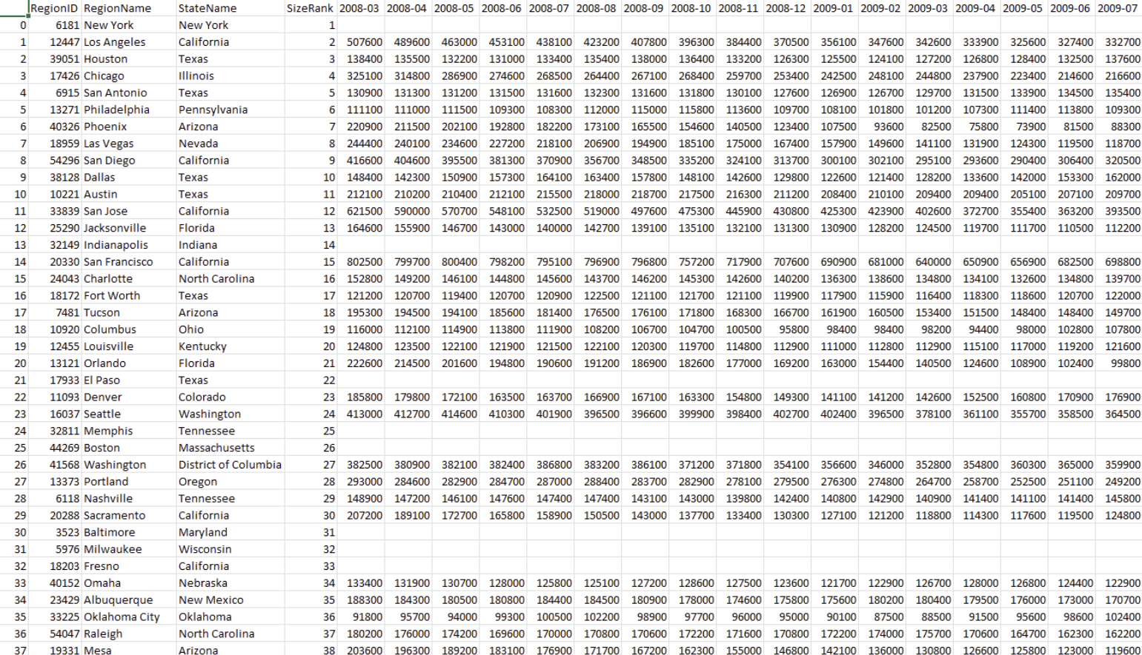
Data Transformation and Preprocessing
Notes:
Matt to share screen after this slide

Slide 9
Machine Learning
Tested three machine learning (ML) models:
Multiple Linear Regression (model of choice)
Random Forest Regressor
Neural Network Model

Slide 10
ML: Data Preprocessing
Import dependencies
Import dataset
Check for any missing values
No encoding needed
Split the data into testing and training sets
Feature Scaling
Notes:
Feature scaling: is a method used to normalize the range of independent variables or features of data. So when the values vary a lot in an independent variable, we use feature scaling so that all the values remain in the comparable range. The variations in our dataset can be minimized simply by dividing the house prices by 1000.

Slide 11
ML: Multiple Linear Regression
Linear relationship between a single dependent continuous variable and more than one independent variables
All variables are quantitative
Independent variable
Housing Prices
Dependent variables
Gas Prices
Unemployment Rate
Average Mortgage Rate
Interest Rate
CPI (Inflation Indicator)

Slide 12
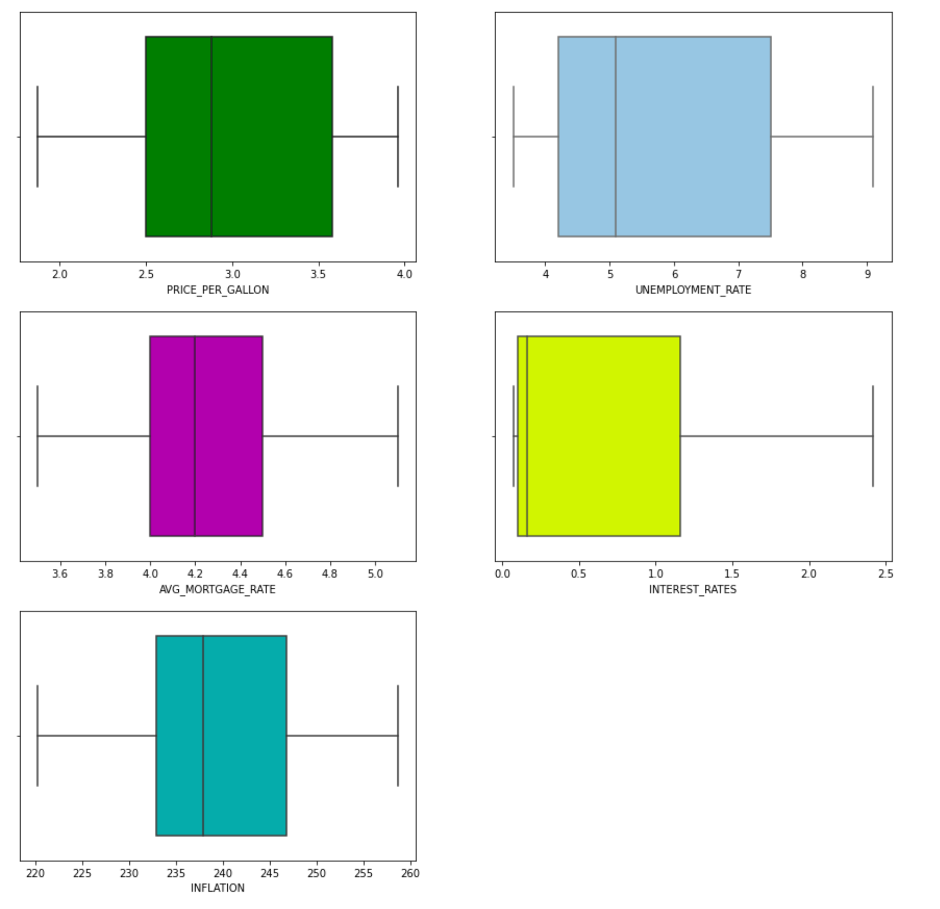
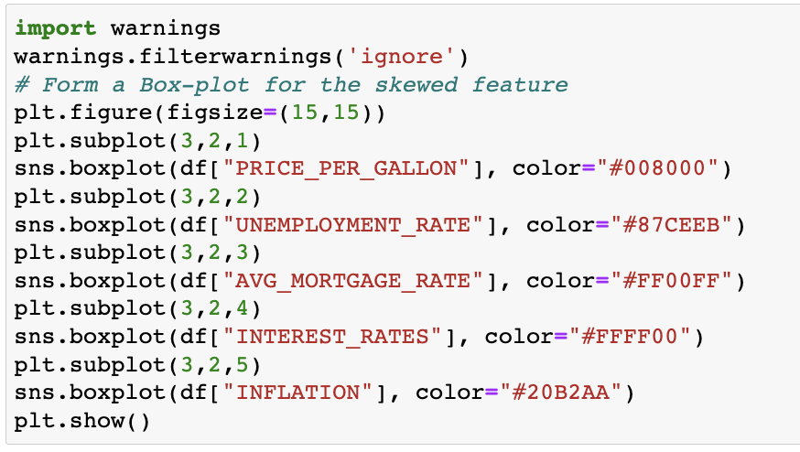
Multiple Linear Regression
Outlier Detection
Boxplot illustrated that there were no outliers in the datasets
Notes:
Outlier detection is important because the presence of outliers in a dataset can result in a poor fit and lower predictive modeling performance. Identifying and removing outliers is challenging with simple statistical methods for most machine learning datasets given the large number of input variables. Instead, automatic outlier detection methods can be used in the modeling pipeline and compared, just like other data preparation transforms that may be applied to the dataset.

Slide 13
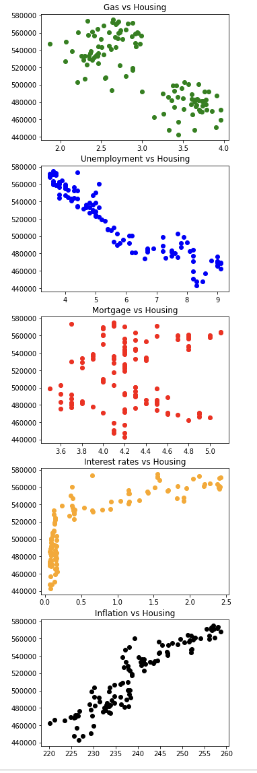
ML: Multiple Linear Regression Feature Engineering and Selection
Feature Engineering –
Finding missing values and removing from dataset
Replacing Region IDs with Zip codes
Feature Selection-
Preparing scatter plots to check linearity
Dropped Mortgage Rates
Notes:
Feature engineering is an important step of ML because by applying FE there is a chance of improving model performance
Feature engineering consists of creation, transformation, extraction, and selection of features, also known as variables, that are most conducive to creating an accurate ML algorithm.
Handling missing values and Replacing region IDs with Zip codes was detailed during the data transformation part of our presentation.
Feature selection: In our dataset, we have 5 input features (Gas Prices, Mortgage rates, Interest rates, Inflation and Unemployment rates) for our model. Based on the above scatter plots, we can see that Interest Rates and Inflation (Consumer Price Index - CPI) have a linear relationship with Housing Prices. The Gas Prices and Unemployment Rates also have a linear relationship with Housing Prices, but with a negative slope, which means that housing prices decrease with increasing as prices and unemployment rates. We can also see that Mortgage rates do not have a linear relationship with Housing Prices. Since Mortgage Rates and Housing Prices do not have linear relationship, in order to move forward with MLR model, we decided to drop Mortgage Rates feature from our dataset.

Slide 14
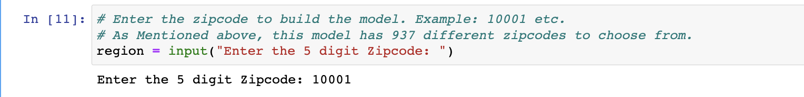
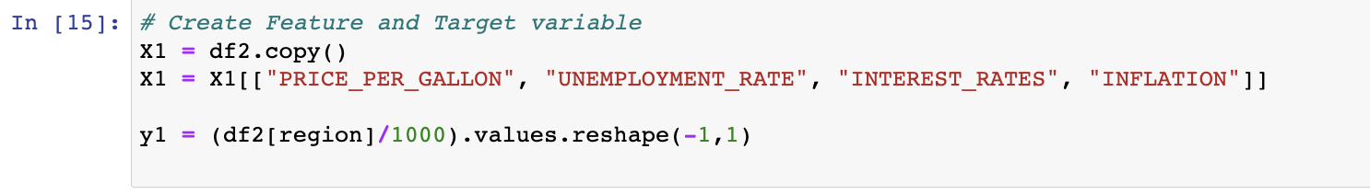
ML: Multiple Linear Regression
STEP 1: Select the Zip code to fit the model
STEP 2: Create the feature and target variables

Slide 15
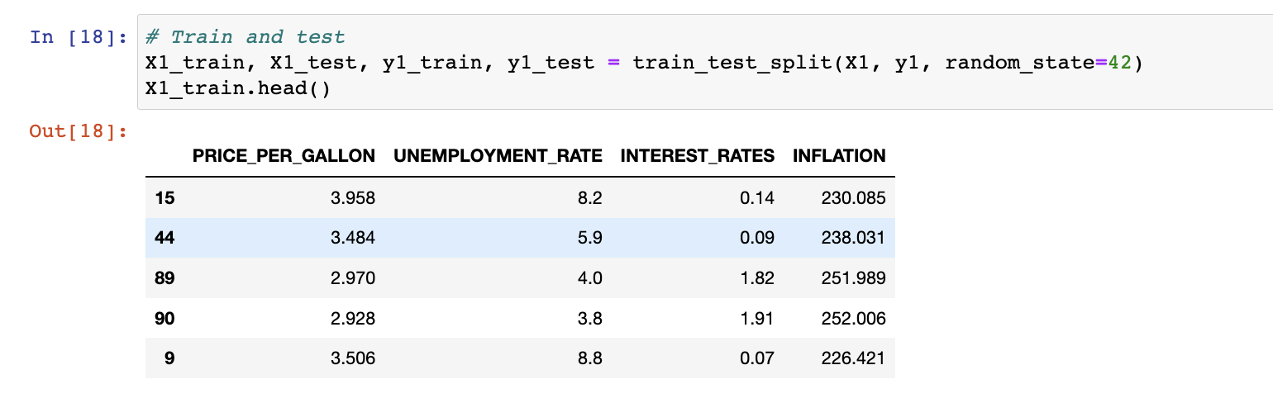
ML: Multiple Linear Regression
STEP 3: Split the data into training and testing sets
STEP 4: Call an instance of the LinearRegression model

Slide 16
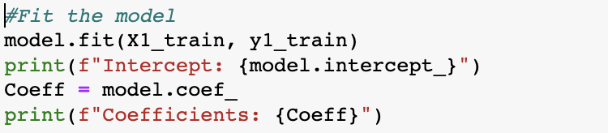
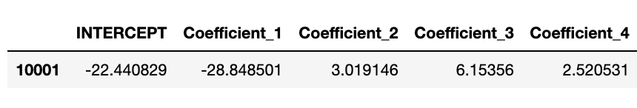
ML: Multiple Linear Regression
STEP 5: Fit the model and calculate the intercept and the coefficients
STEP 6: Predict housing prices

Slide 17
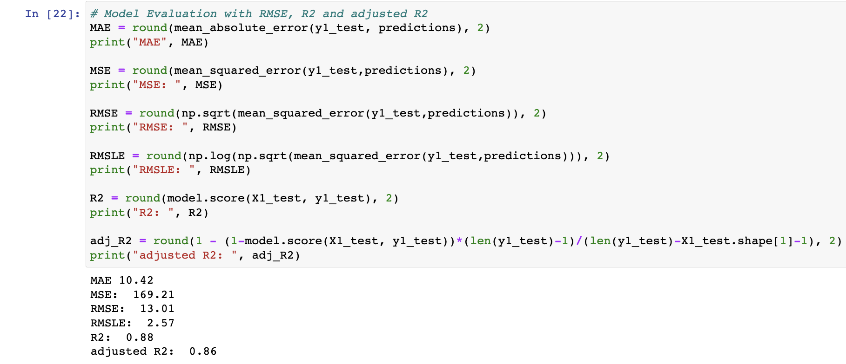
ML: Multiple Linear Regression Model Evaluation
Mean Absolute Error (MAE)
Mean Absolute Error (MSE)
Root Mean Squared Error (RMSE)
Root Mean Squared Log Error (RMSLE)
R Squared (R2)
Adjusted R Squared (Adj R2)
Notes:
MAE is a very simple metric which calculates the absolute difference between actual and predicted values.
MSE represents the squared distance between actual and predicted values. we perform squared to avoid the cancellation of negative terms and it is the benefit of MSE
RMSE The metric is very helpful when you are developing a model without calling the inputs. In that case, the output will vary on a large scale.
To control this situation of RMSE we take the log of calculated RMSE error
R2 Coefficient of Determination or sometimes also known as Goodness of fit. calculates how must regression line is better than a mean line.
Adj R2: The disadvantage of the R2 score is while adding new features in data the R2 score starts increasing or remains constant but it never decreases because It assumes that while adding more data variance of data increases.

Slide 18
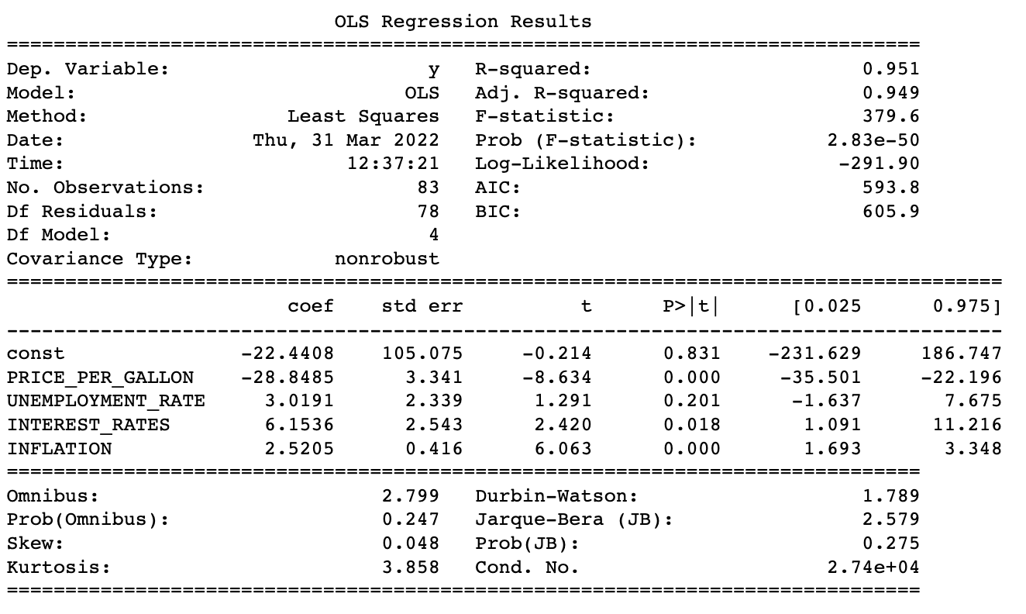
ML: Multiple Linear Regression Model Evaluation
Using statsmodel Python library (OLS function)
Notes:
statsmodels is a Python library built specifically for statistics.
Ordinary Least Squares regression (OLS) is a common technique for estimating coefficients of linear regression equations which describe the relationship between one or more independent quantitative variables and a dependent variable
Notice that the coefficients captured in this table match with the coefficients generated by sklearn.

Slide 19
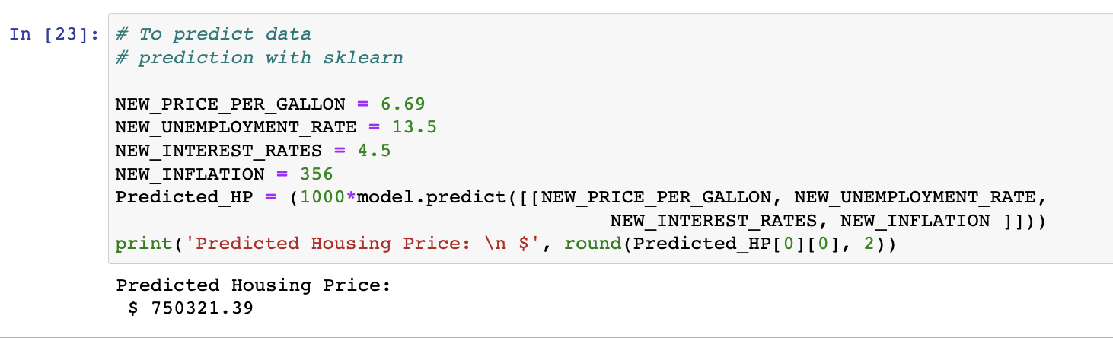
ML: Multiple Linear Regression Model Evaluation
Providing desired inputs for features and predicting housing prices in zip code 10001

Slide 20
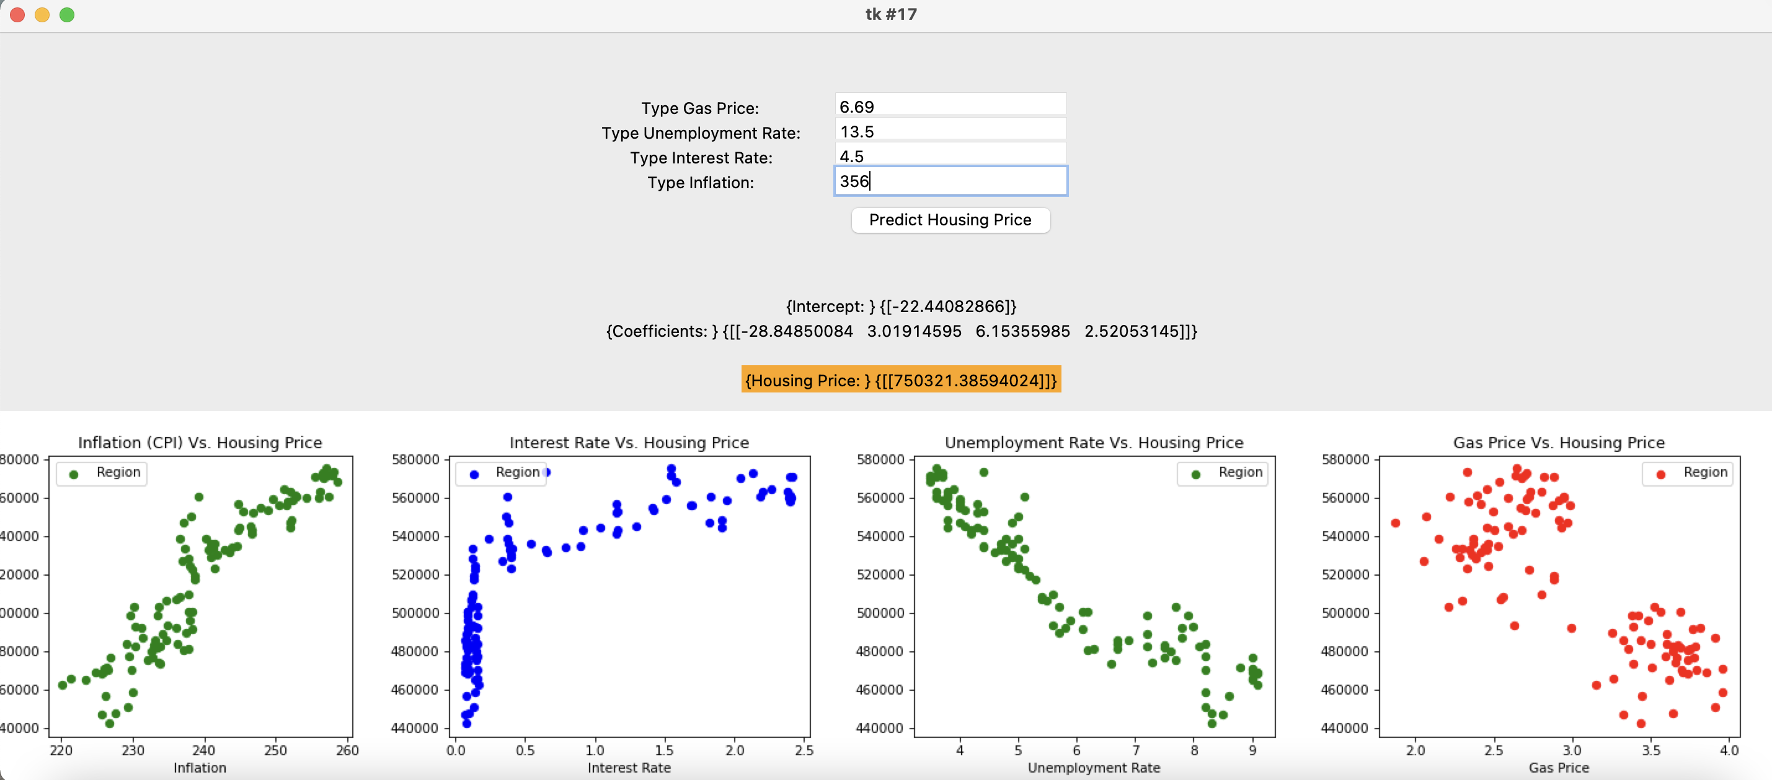
ML: Multiple Linear Regression Graphic User Interface (GUI)
GUI to allow user to input
Tkinter Python library
Notes:
We created a GUI that will allow users to input the independent variables in order to get the predicted result. Tkinter is the standard GUI library for Python. Python when combined with Tkinter provides a fast and easy way to create GUI applications.
Once you run the code, you’ll see this GUI, which includes the output generated by sklearn and the scatter diagrams for the selected Zipcode.

Slide 21
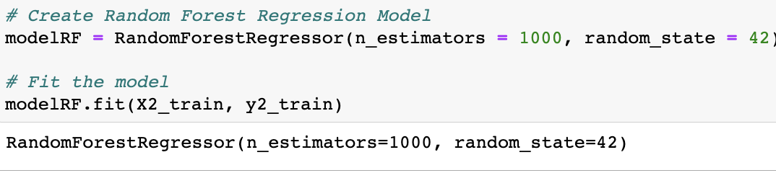
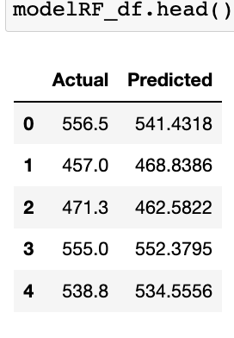
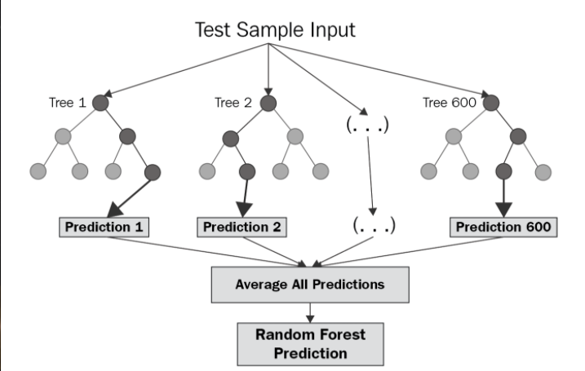
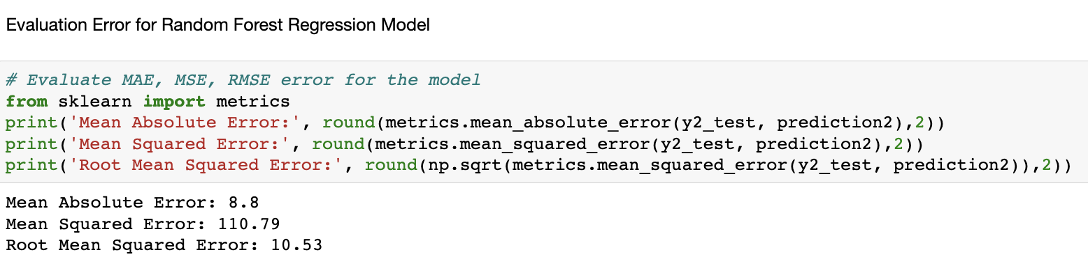
ML: Random Forest Regressor
Notes:
Random forest is a type of supervised learning algorithm that uses ensemble methods (bagging) to solve both regression and classification problems. The algorithm operates by constructing a multitude of decision trees at training time and outputting the mean/mode of prediction of the individual trees.

Slide 22
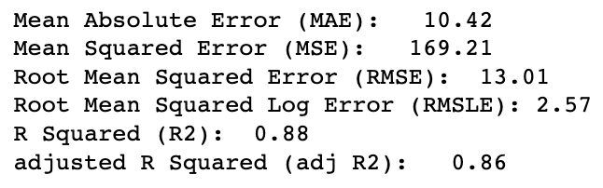
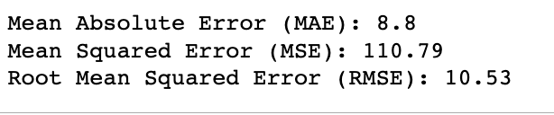
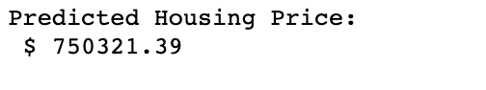
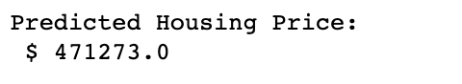
ML: Comparison– Multiple Linear Regression Vs. Random Forest Regression
Multiple Linear Regression | Random Forest
Evaluation Metrics:
Predictions with similar inputs:
Random Forest is Better?
Why we can’t use this model?
Decision trees, less chance of overfitting
Greater Accuracy
Cannot Extrapolate

Slide 23
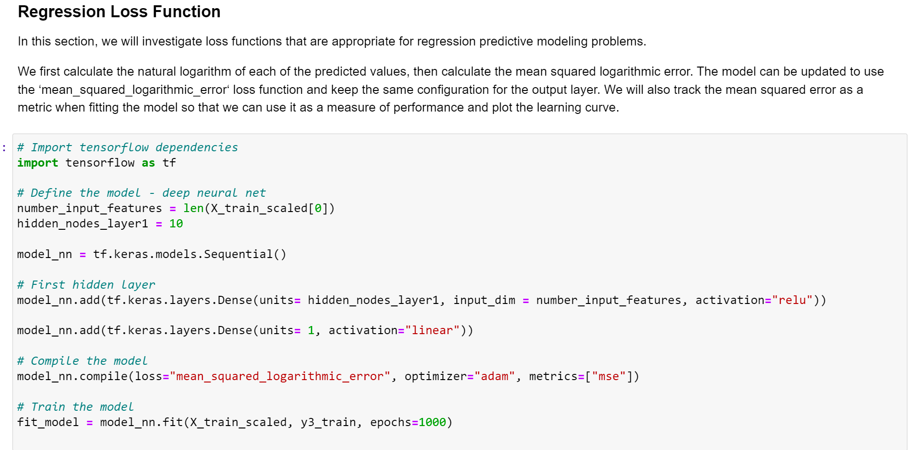
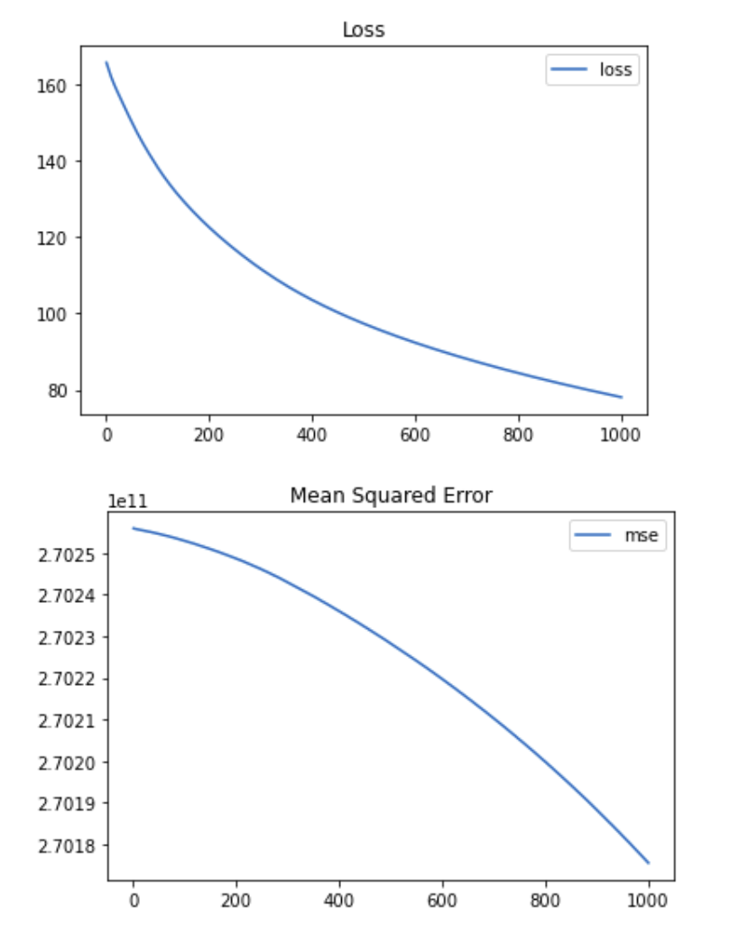
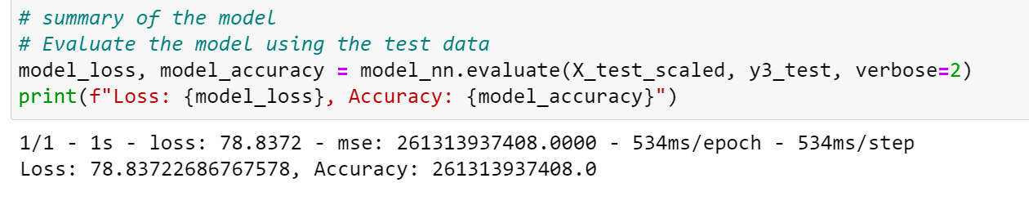
ML: Neural Network Model

Slide 24
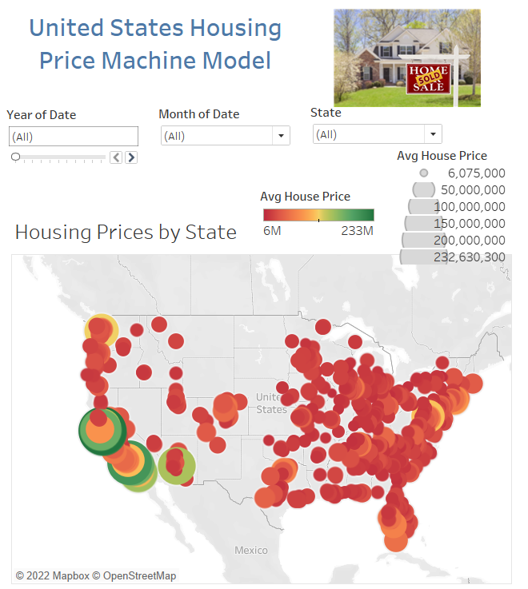
Data Visualizations & Tableau
Outlier Project | Tableau Public

Slide 25
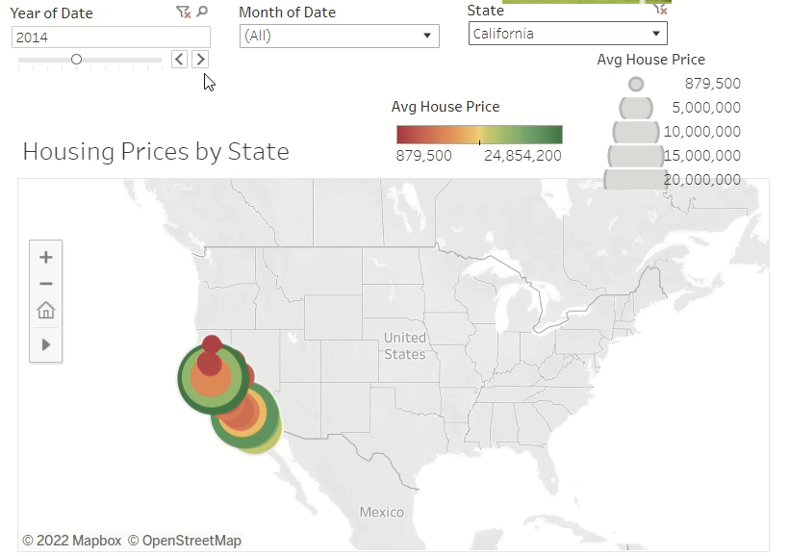

Slide 26
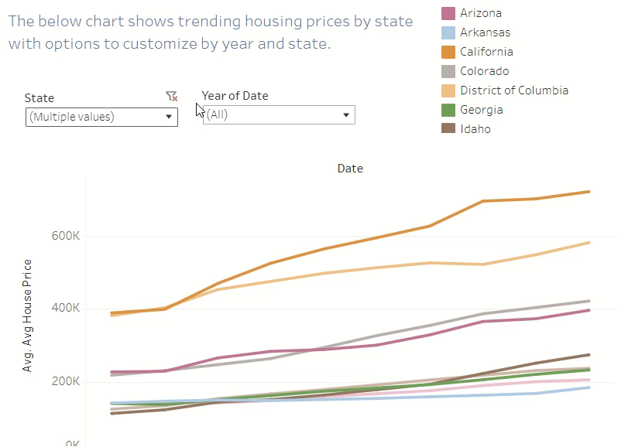

Slide 27
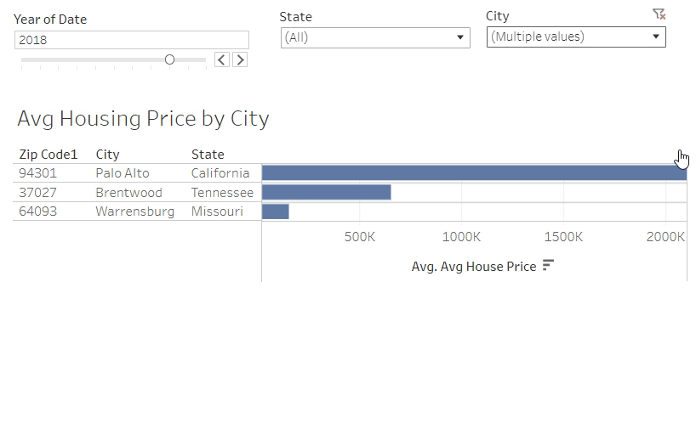

Slide 28
Recommendations and Lessons Learned
Recommendations
Research more region-specific data points
Lessons Learned
Add additional variables
Identify more region-specific variables
Identify more comprehensive data source to eliminate null values

Slide 29
Questions?

Slide 30
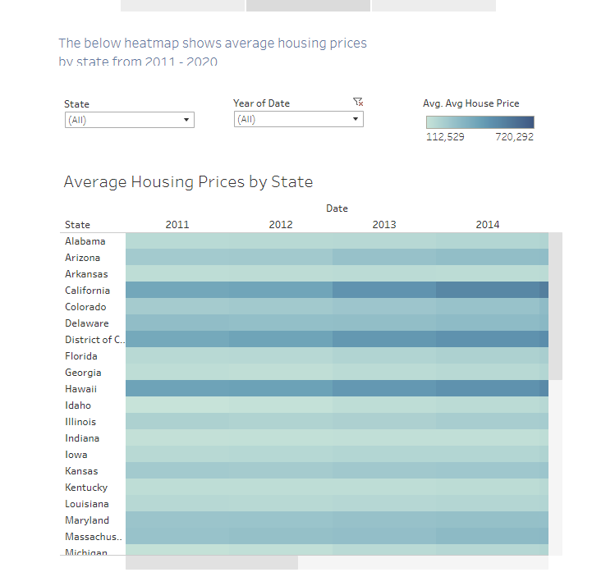

Slide 31
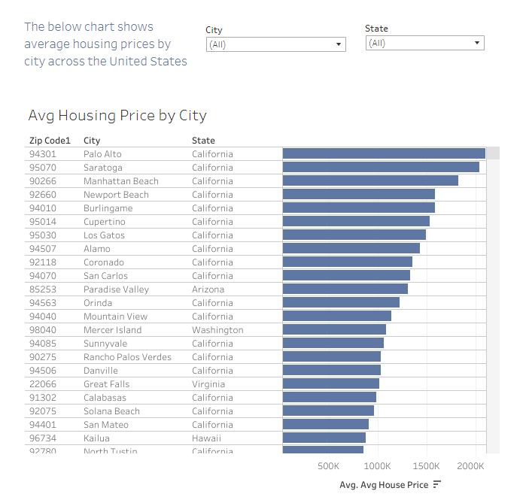

Slide 32
Appendix

Slide 33
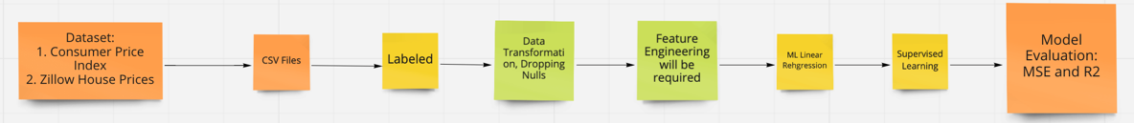
Machine Learning Flow Chart
Datasets (CSVs, Labeled):
Consumer Price Index
Housing Prices
Mortgage Rates
Gas Prices
Unemployment Rates
Data Transformation:
Dropping null values
Filtering dates
Dropped unnecessary columns
Transposed data
Set date as index, region id as column headers
Converted date to uniform date-time
Assigned zips and coordinates to locations
Machine Learning Model:
Multi-Linear Model
Supervised Learning
Model Evaluation:
MSE
R2

Slide 34
Icons Icons should be primarily used as a visual aid, as a way to break up large amounts of text and content, or as a visual cue of the content that follows. Get the full set of icons for presentations
INDUSTRY SECTORS
Aeronautics | Agriculture | Architecture | Automotive | Construction | Education and research | Energy | Financial services | Healthcare | Engineering and manufacturing | Professional services, media | Sports
Government | Retail | Technology | Media and broadcasting | Travel and transportation | Education | Law | Science | - | - | - | -
MAPS / LOCATION
Globe, global, earth | Globe, global, earth | Navigation, GPS, POI, location, map | Map, location, GPS, directions, navigation | Navigation, GPS, POI, location, map | Map, location, route, quest, destination, journey | Download map, receive location | - | - | - | - | -
MONEY / FINANACE / RETAIL / CONSUMER
Shopping cart, store | Store, bag, shop | Money, dollar sign, cash, revenue, currency | Revenue, financial report, funds | Money, currency, coins | Bank, piggybank | Compare, balance, finance, justice | Credit card, payment, charge, debit card | Mobile payment, digital payment, e-commerce | Barcode scanner | Tag, sale, shopping | Bank

Slide 35
Get the full set of icons for presentations
OBJECTS / TOOLS
Alarm clock | Hourglass, timer | Clock | Flashlight | Funnel | Calculator | Binoculars | Scissors | Camera | Battery, power, charge | Magnifying glass | Tools, screwdriver, wrench
Paperclip | Pushpin, thumbtack | Key | Lock | Safe | Piggybank | Bag | Ballot box, drop box | Box, archive, storage | Present, giftbox | Box, package, shipping | Briefcase, business, work, job
Books, reading | Book, dictionary, novel | Notebook, journal | Pencil | Paintbrush | Paint palette, color | 3D, hologram | Trophy, award | Ribbon, award, reward, accomplishment | Ribbon, award, reward, accomplishment | Flag, finish line | Flags, finish line, win, race
Open door, entryway, opportunity | Clipboard | Megaphone, speaker, speech, announcement | Microphone | CD, music album | Headphones | Headset | Eye glasses | Bike, bicycle | Umbrella, bumbershoot | Balloon, party, celebration | Rocking chair
Remote control | Robotic, manufacturing, mechanical, automation | Forklift | Gears | Traffic cone, construction | Flask, chemistry, science, beaker | Maze, puzzle | Target, bullseye, aim, arrow, dartboard, darts, archery | Games, strategy, chess, poker | Musical instrument, drums | Pizza, food | Lightbulb

